Slide 1
PCA Summary on Chem data
Last edited: 10/23/2019

Slide 2
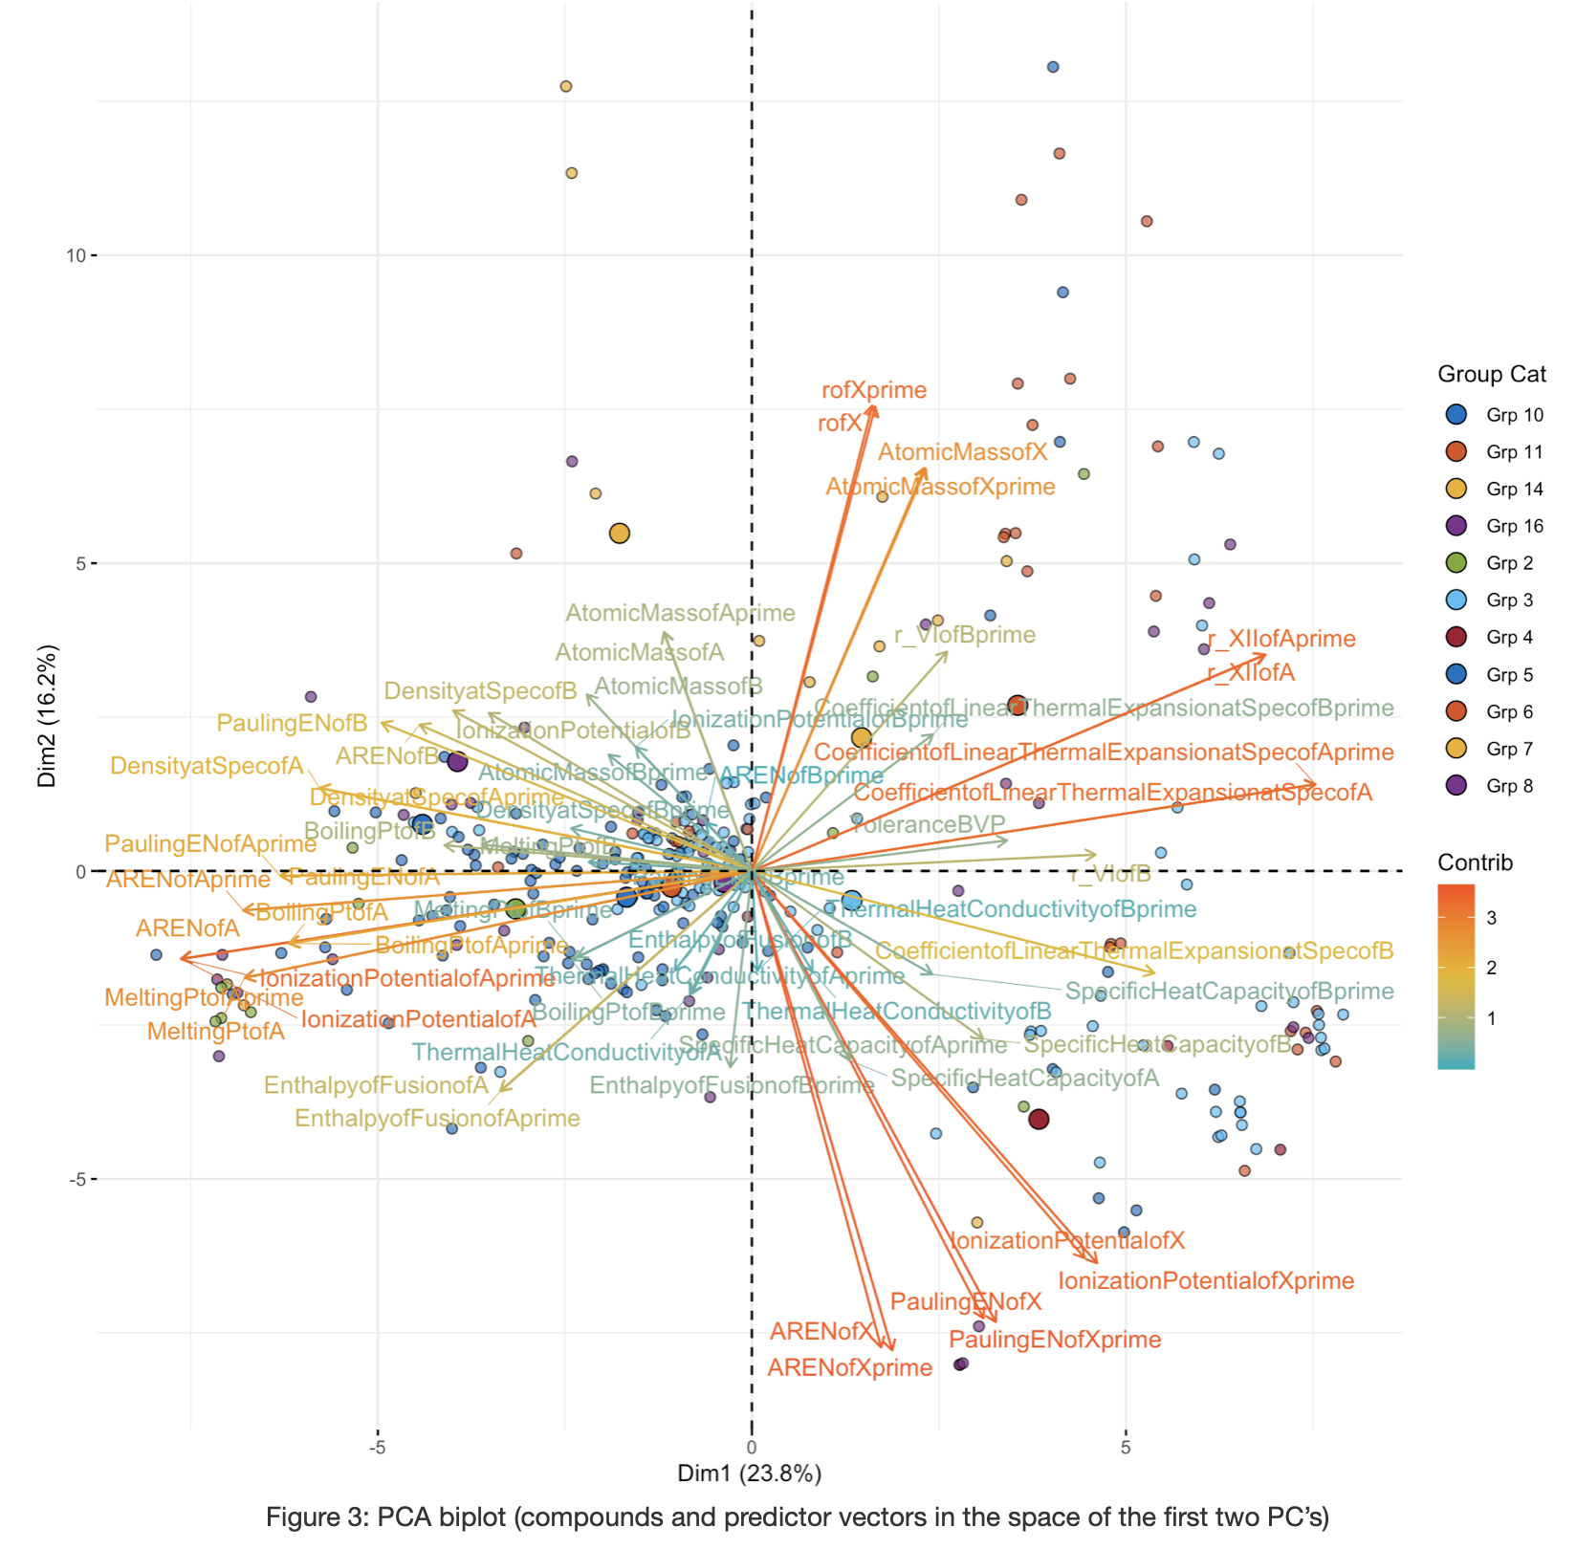
PCA Biplot
Vectors of predictors in space of PC1 and PC2
Color bar of vectors represents contribution of predictors
Data points in space of PC1 and PC2
Color of data points allows us to distinguish chem group
Grp 3 and Grp 5 are the first two largest groups

Slide 3
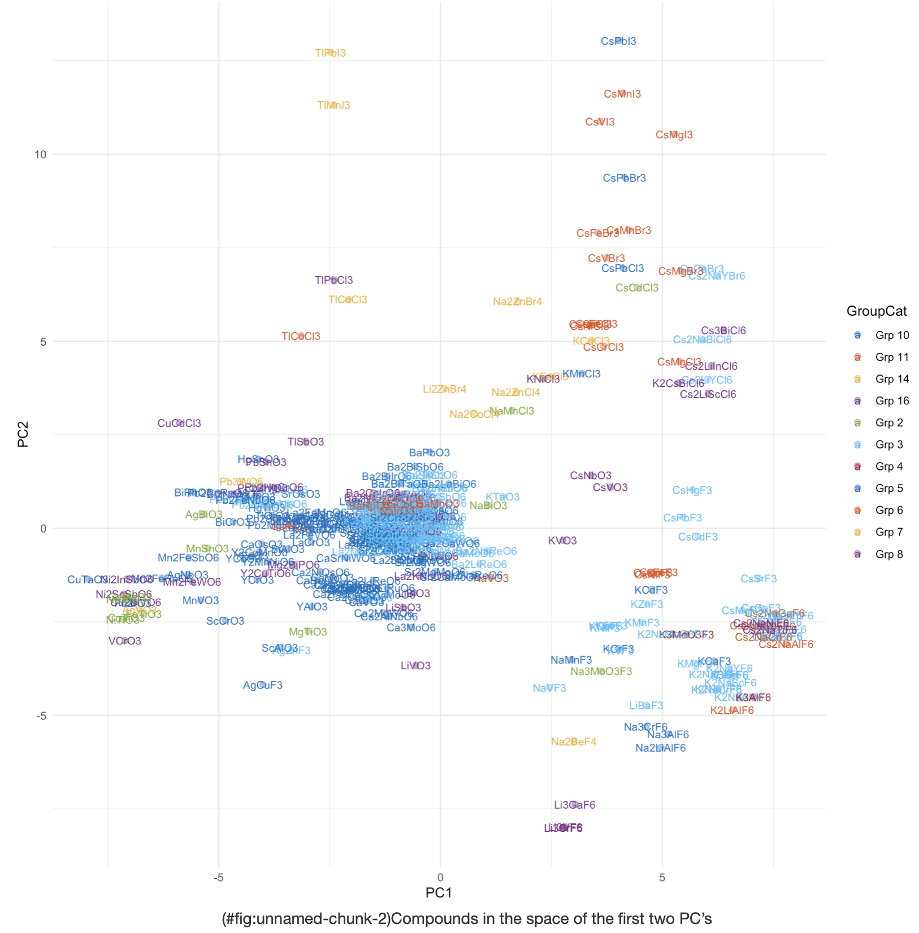
Compounds in PC space
Compounds in space of PC1 and PC2
Color of text represents chem group
Grp 3 and Grp 5 are the first two largest groups

Slide 4
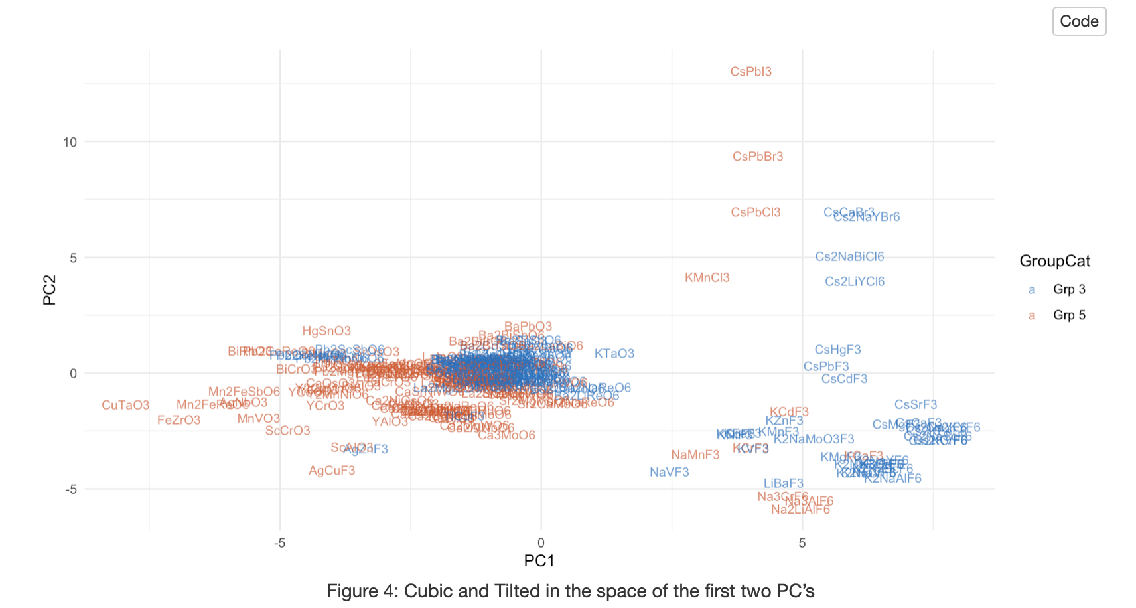
Cubic and Titled in PC space
Plot only Cubic and Titled in space of PC1 and PC2
Color of text represents two chem groups
Two chem groups mingle together at PC1=0 and PC2=0

Slide 5
Cubic vs Tilted
Last edited: 10/23/2019

Slide 6
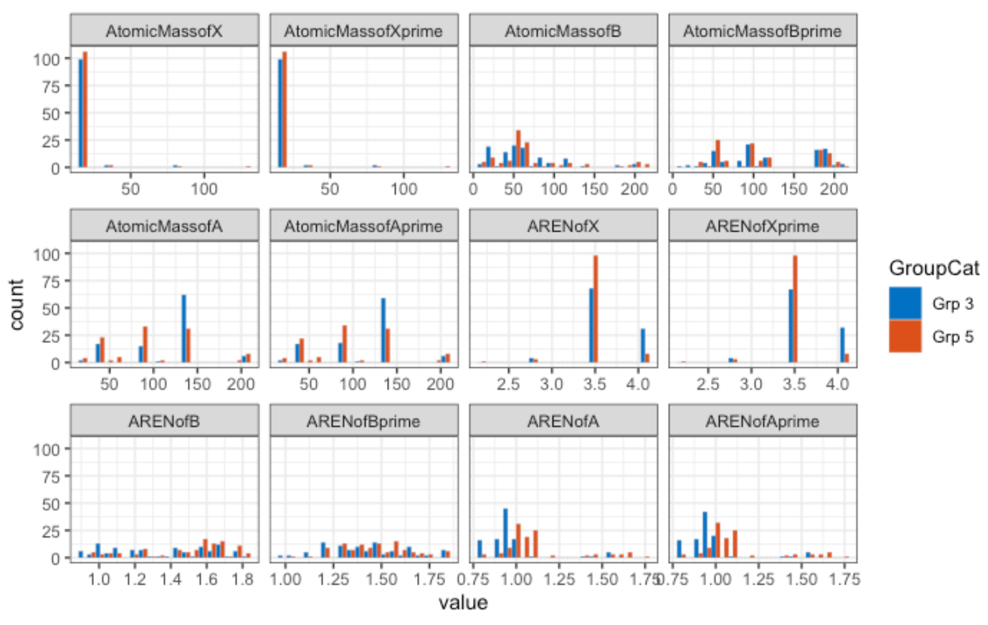

Slide 7
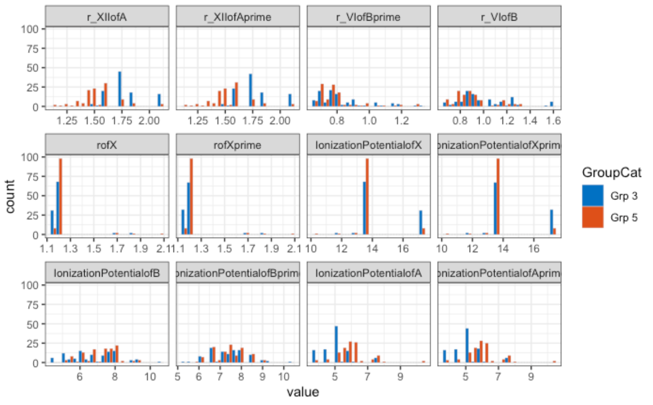

Slide 8
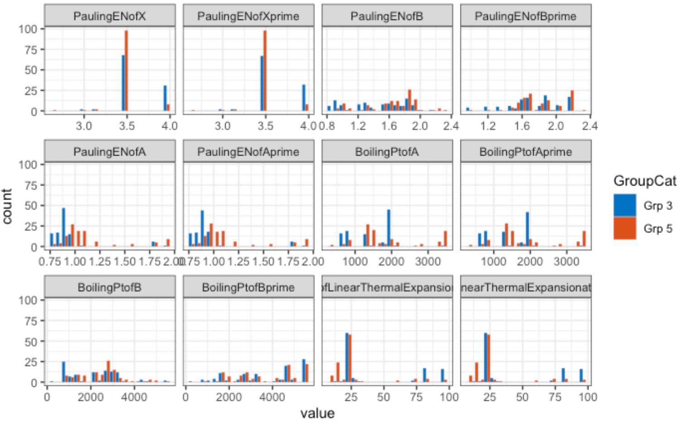

Slide 9
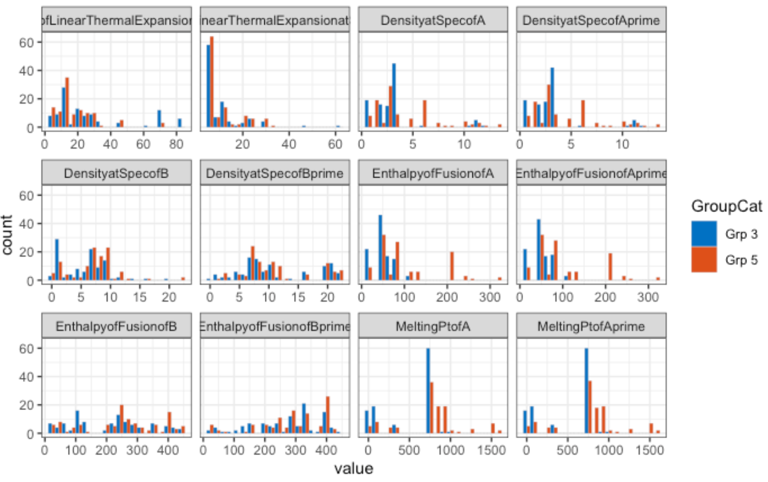

Slide 10
